Slide 1
Graph Redesign Project

Slide 2
Bad Graph: Definition & Examples
A graph that misrepresents data and does not convey a clear message that might lead to wrong conclusions.
A few examples of bad graphs are:
A graph from USA Today about welfare of USA
A graph from CNN about Terry Schiavo

Slide 3
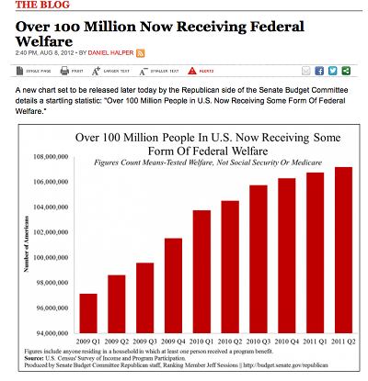
A graph from USA Today about welfare of USA
As we can see from this graph, they have shown that over 100 million people are receiving federal welfare whereas in the y-axis we can see that the amount starts from 94 million which means that there isn’t a lot of increase in welfare money over the years, so the graph is misleading and we can say that it is a bad graph.

Slide 4
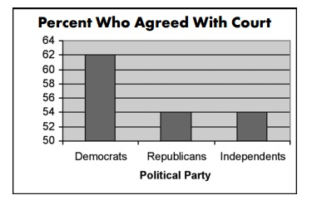
A graph from CNN about Terry Schiavo
Now in this graph they show the percentage of people who agreed to remove Terry from life support. This graph shows that higher percentage of Democrats agreed to remove life support compared to Independents and Republicans, but if we see the y-axis Democrats voted 62% which is slightly higher compared to Independents and Republicans with 54%. Hence this graph is misleading the readers and is considered as a bad graph.

Slide 5
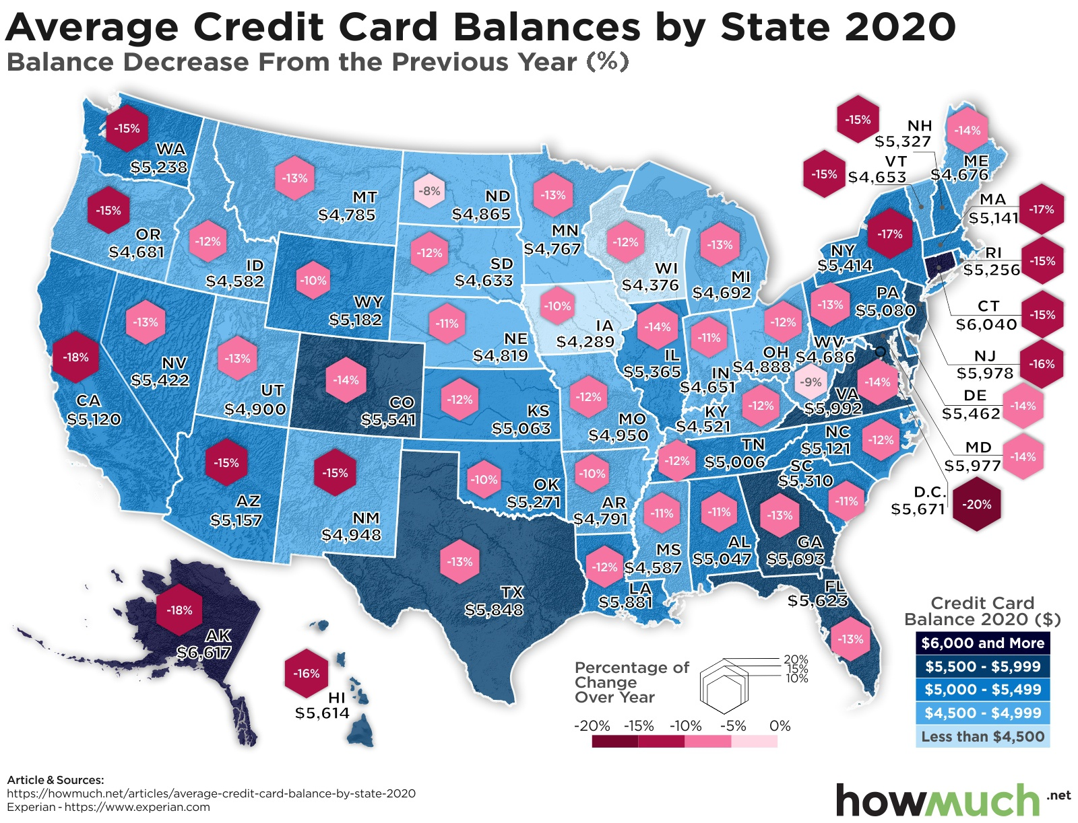
Bad Graph we chose for the project:

Slide 6
Mistakes in the graph
In the graph we can see that the average credit card balance by state in 2020 and balance decrease percentage from 2019 in USA is poorly visualised and hard to understand.
In large states like Texas, Arizona etc. we can understand the information being displayed but to the right most side of the country, a lot of data is crowded and some are shown out of the map via lines and information is not clear for the reader.
There is no clear grid for the representation and no legend for the states due to which new readers might be confused among the states.
The graph clearly goes against the guidelines which should be followed for a good graph.

Slide 7
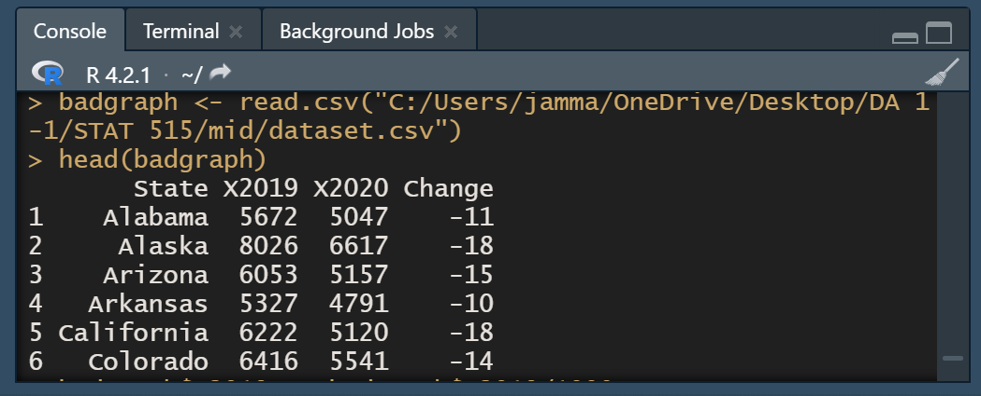
Refining the dataset
The rows in the dataset show the credit card debt in year 2019 and 2020 and the change in debt percentage for each state.
A modification which we made was simplifying the debt values by dividing them with 1000 so that they can be clearly represented and the scale values will not be crowded.

Slide 8
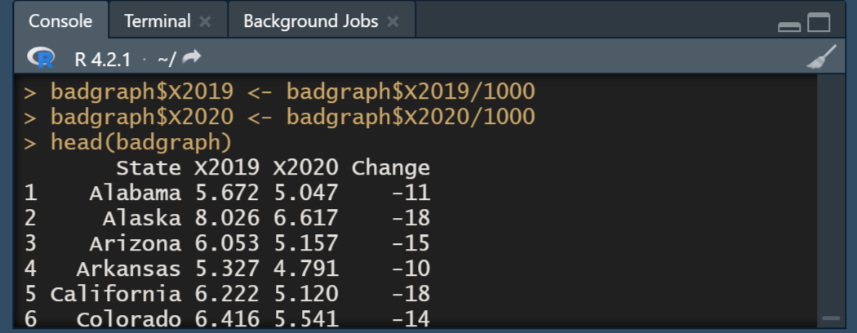
Refining the dataset
Now the values can be clearly plotted on the scale.

Slide 9
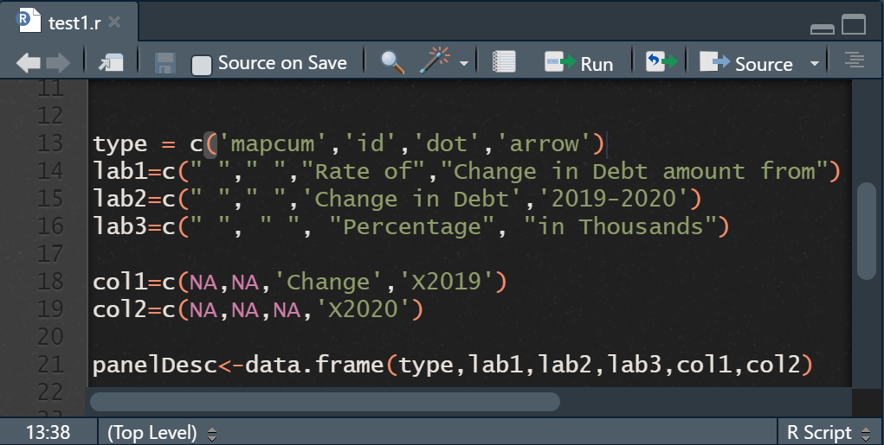
Designing the Micromap
By using micromapST() package in R Studio, we designed the micro map for the credit card debt data and sorted it by percentage change in ascending order.
We chose a cumulative type of map representation and we showed the percentage representation by dot plot, change in debt amount using arrow plot and specific clear labels for the columns.

Slide 10
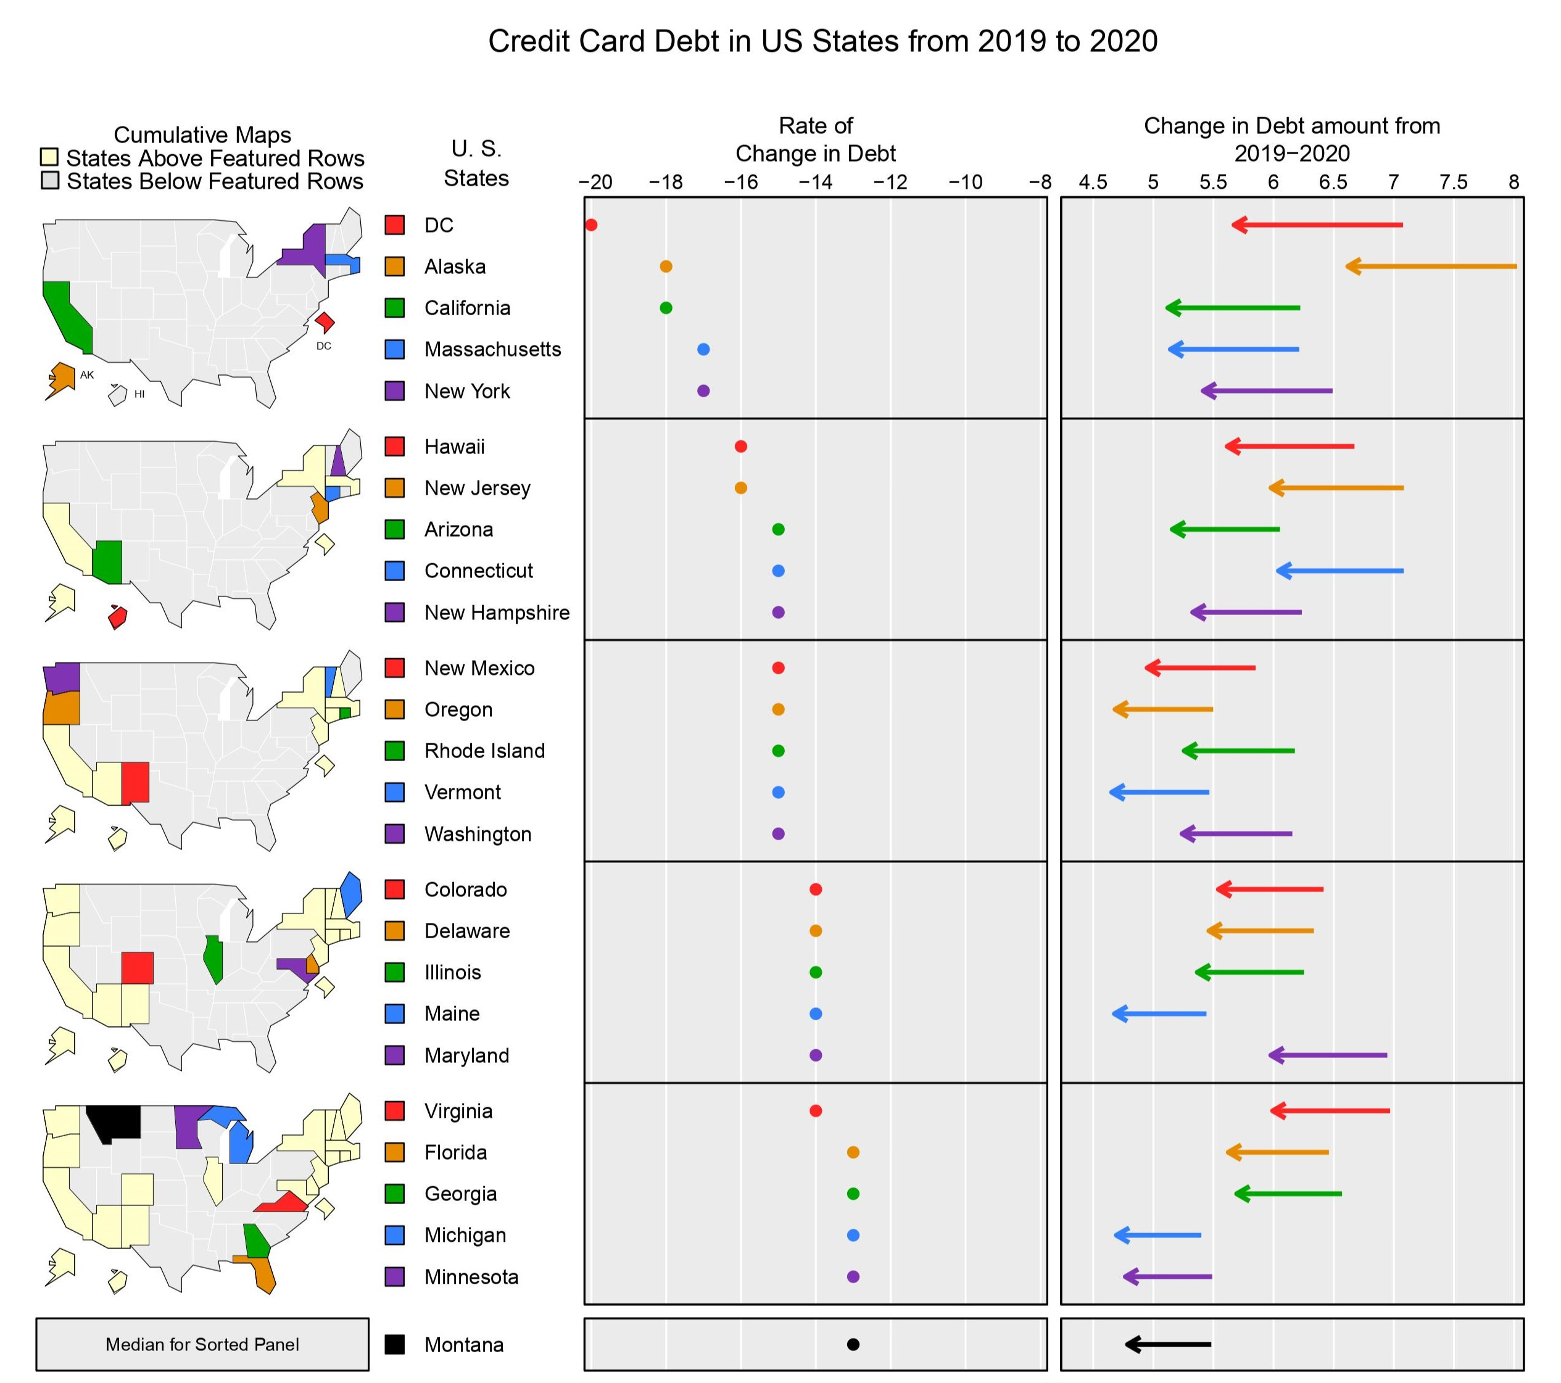
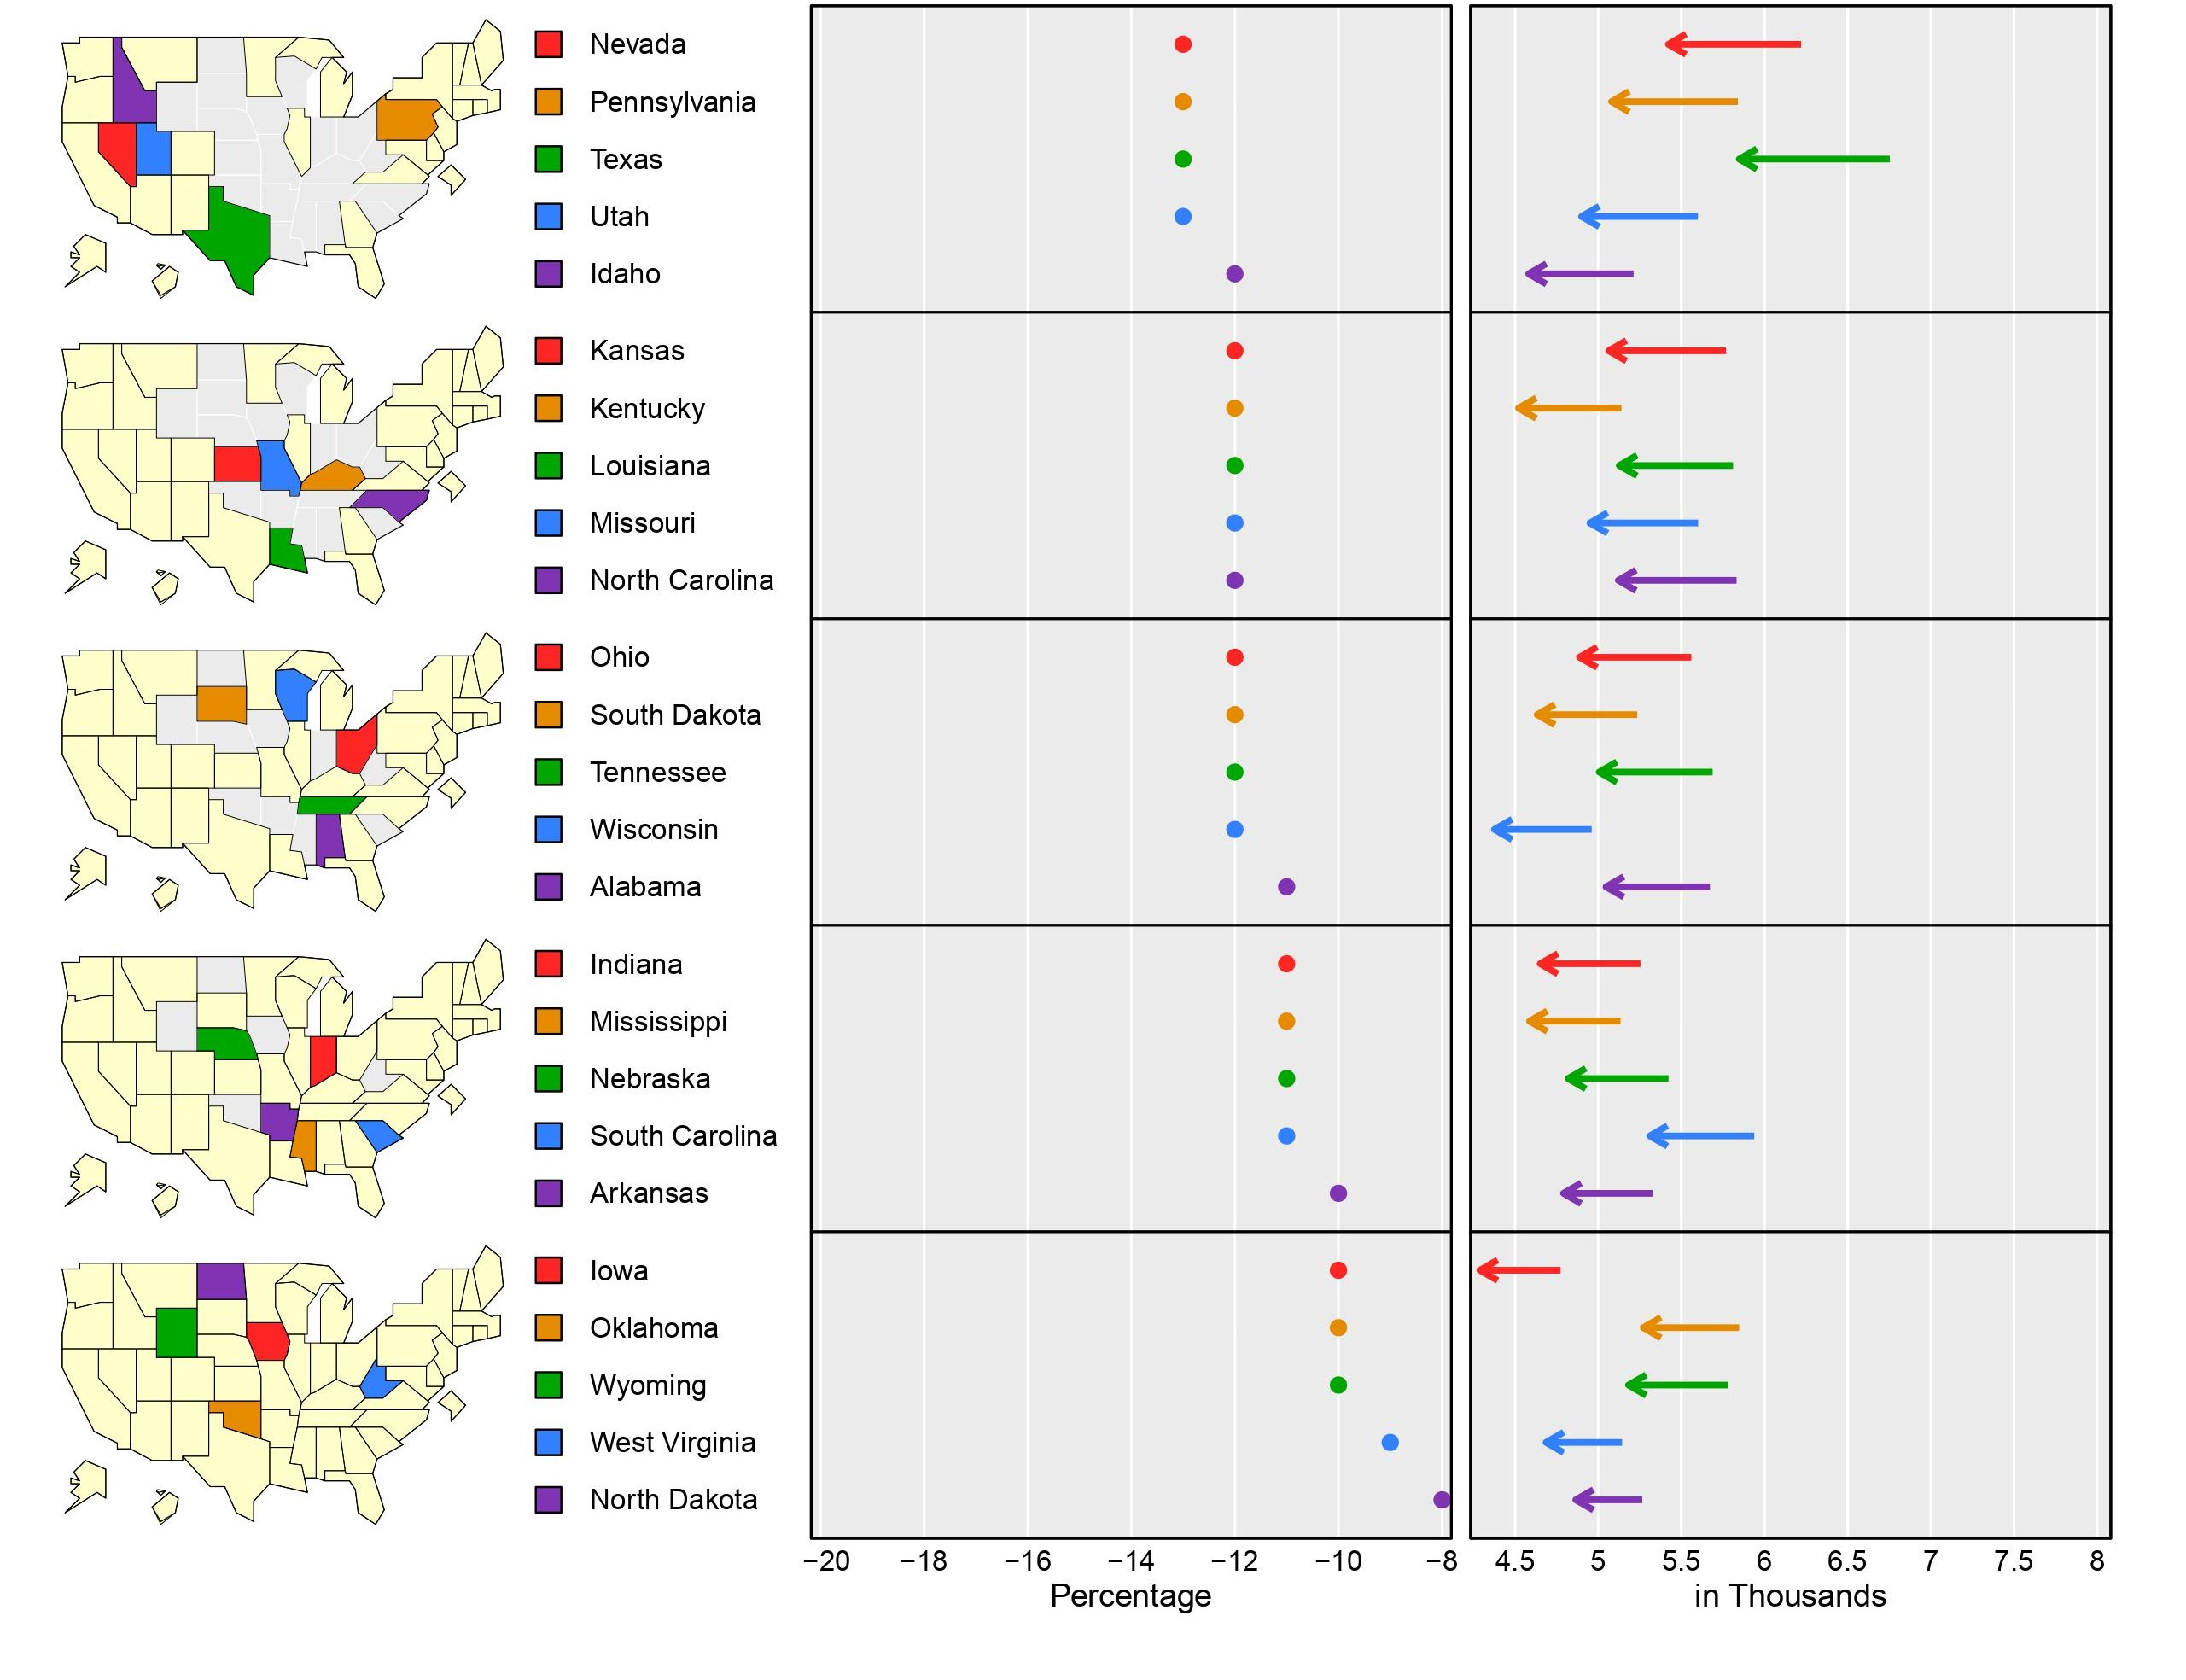
Redesigned Graph

Slide 11
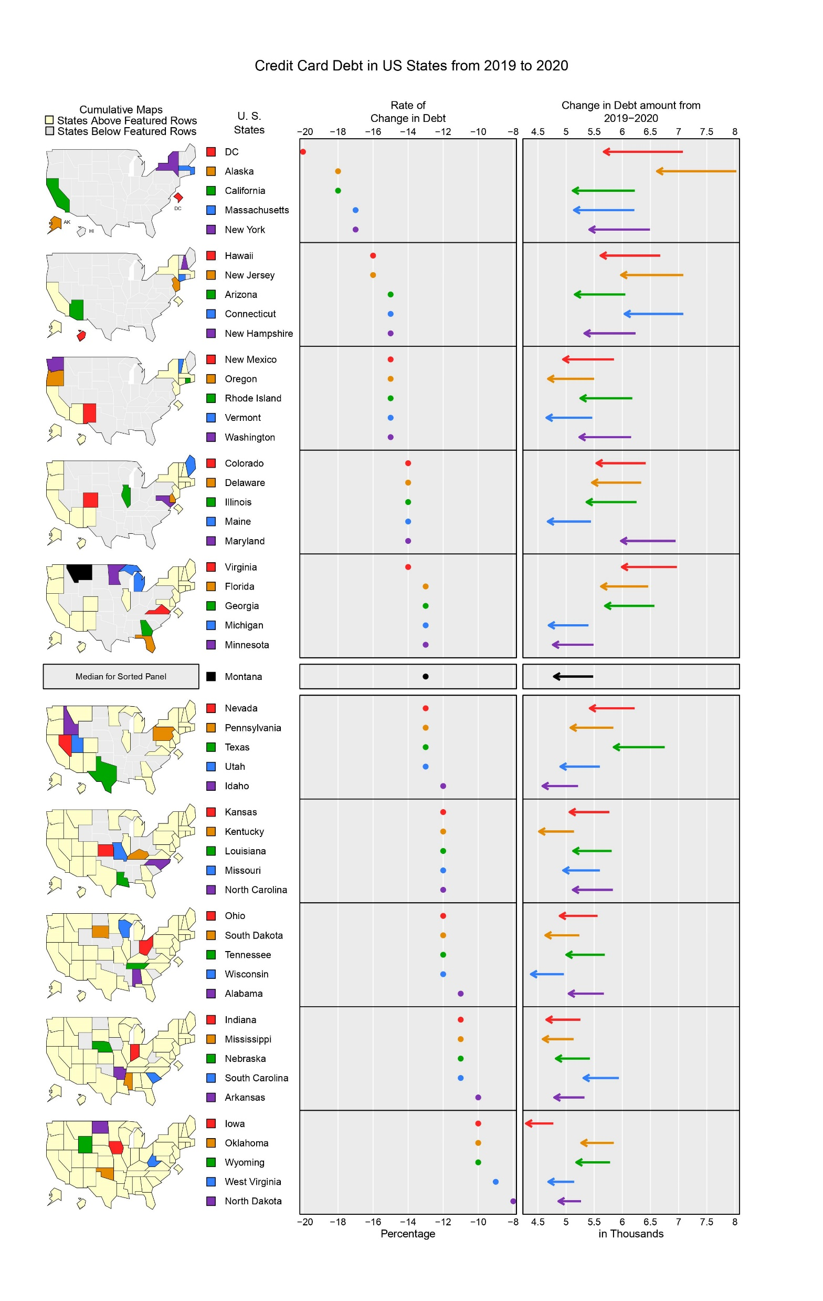
Old graph vs Redesigned graph

Slide 12
Challenges
Finding a bad graph wasn't the hardest challenge we had to solve, it was finding a bad graph along with the data that was used to make the graph.
Thinking of an appropriate type of graph for redesigning and visualizing the bad graph into meaningful graph was another challenge.

Slide 13
Conclusion
We redesigned the bad graph by following the four design guidelines of accurate comparisons, simplify appearance, interpretation, and reader engagement.
The libraries we used were tidyverse and micromapST()
In this project we learnt about the principles for plotting a good graph and how to redesign a bad graph to be visually informative and clear for the reader.

